Slide 1
AI World
AI tools finder
Guided by: Prof. Bhavika Patel

Slide 2
Table of Content
Introduction
Team Members
Importance of AI in Today's World
Project Overview
Functionality Overview
Current Status
Website Hosting
Benefits of AI Tools Suggester
Future Development Plans
Project Benefits
Conclusion
References

Slide 3

Introduction
Welcome to our presentation on the AI tools finder - a revolutionary new tool that will change the way you work with artificial intelligence!
Our team has been hard at work developing this cutting-edge website, which is designed to help users find the right AI tools for their specific needs. Whether you're an engineer, a student, or just someone interested in exploring the world of AI, the AI tools finder has something for everyone.

Slide 4

Team Members
Our team is made up of three highly skilled individuals who have been working tirelessly on this project.
- 22DCE068 HARSH PATEL
- 22DCE069 HEMAX PATEL
- 22DCE070 HET PATEL
Each member of our team brings unique skills and experience to the project. We are confident that the AI tools suggester will be a valuable resource for anyone looking to streamline their workflow and increase productivity.

Slide 5

Importance of AI in Today's World
Artificial Intelligence (AI) has become an integral part of today's world. Its impact has been immense, with AI being used to improve efficiency, reduce costs, enhance decision-making processes and productivity increases.
According to a recent study, the global AI market is expected to reach $267 billion by 2027, with a compound annual growth rate of 33.2%. For instance it’s being heavily used in the healthcare industry, In finance, and portfolio optimization, In transportation etc.

Slide 6

Project Overview
The project we are working on is an AI tools suggester. The structure of the project will include Home page and main page.
a category selection bar, different ai tools with description and their respective link etc. We have completed all HTML and CSS work, which includes the design of the user interface and the layout of the page.
Currently, We are also working on improving the user experience by adding more visual aids and making the interface more user-friendly.

Slide 7
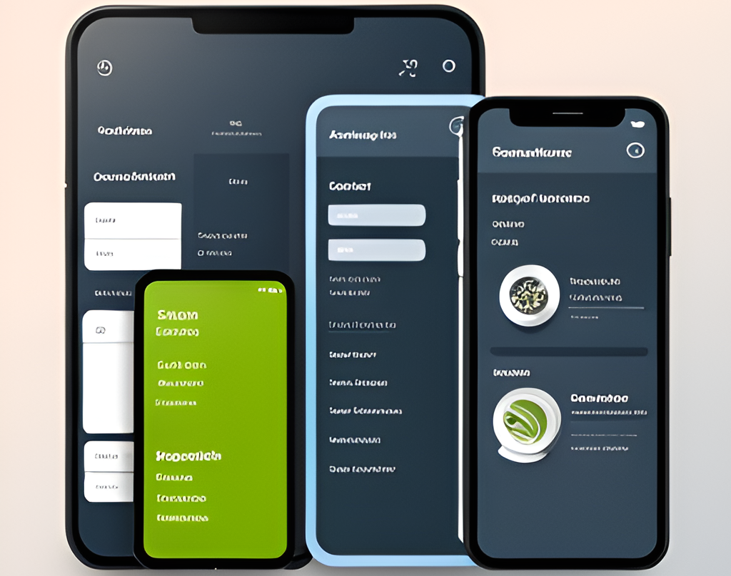
Functionality Overview
Our project aims to provide a user-friendly interface that allows users to easily find their AI tools. Sort through large amounts of data using category section.
We understand the importance of providing a seamless user experience. Our goal is to make the process of finding the desired information as efficient as possible.

Slide 8

Current Status
We have made significant progress in the project so far. The HTML work is completed, and the CSS work is on the verge of completion. Only some adjustments are remaining.
Additionally, we need to ensure that the website is hosted completely without any errors.

Slide 9

Website Hosting
The only main work remaining in the project is the website hosting. Website hosting is the main part of the project.
After the remaining CSS work is completed , website hosting will be done.

Slide 10

Benefits of AI Tools Suggester
The AI tools suggester offers numerous benefits to its users.
One of the most significant advantages is that it can save time by suggesting the best AI tools for a specific task.
Another benefit of the AI tools suggester is that it provides personalized recommendations based on the user's preferences and needs.

Slide 11
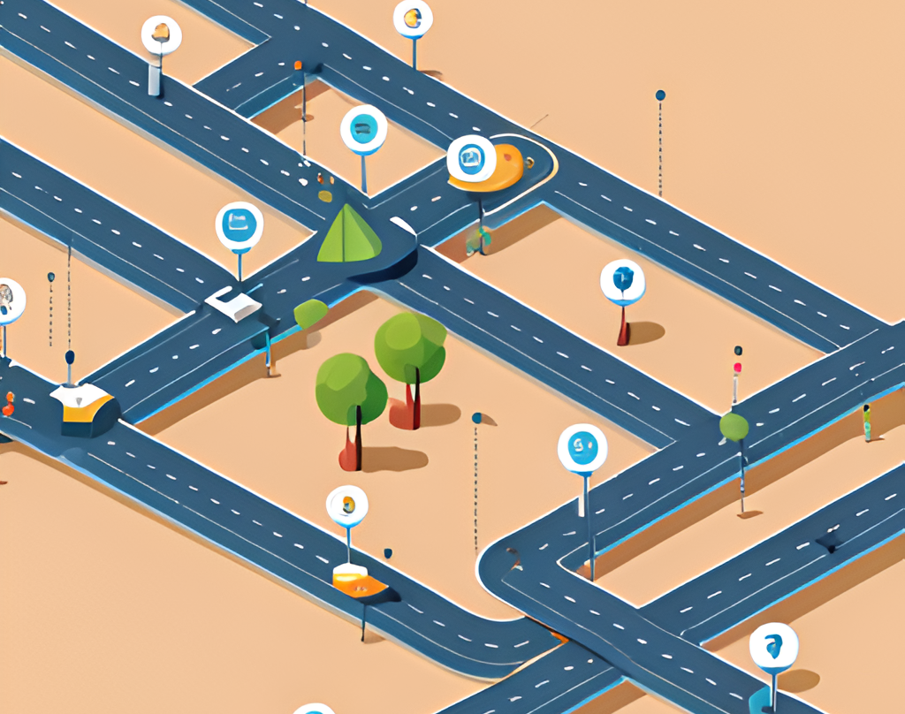
Future Development Plans
We have several exciting future development plans for the AI tools suggester. First, we will be completing the remaining CSS and website hosting soon.
Another area of focus for future development is conducting extensive user testing and incorporating feedback from users to make improvements.
Finally, we will consider integrating with other popular productivity tools to provide a seamless experience for users.

Slide 12

Project Benefits
The project benefits users in a number of ways. This will save users time and frustration, and make it easier for them to find the information they need.
For the project team, the benefits are equally significant. The project provides an opportunity to develop new skills and gain experience working on a real-world project.

Slide 13

Conclusion
In conclusion, we have discussed the importance of AI in today's world and how it can be applied to improve productivity Additionally, we have discussed the challenges faced during development and how they were overcome.

Slide 14

References
The references used in this project were carefully selected to ensure that they were credible, reliable and relevant.
Some of the key sources we used include Apna college on Youtube, W3Schools and other helpful websites.

Slide 15

Thank you

